Slide 1
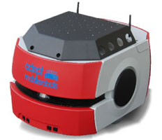
Increased Visibility Sampling for Probabilistic Roadmaps
Robotics and Artificial Intelligence Laboratory
Indian Institute of Information Technology, Allahabad
Research Sponsored By:
Rahul Kala
Presentation of the paper: R. Kala (2018) Increased Visibility Sampling for Probabilistic Roadmaps, In Proceedings of the IEEE Conference on Simulation, Modelling and Programming for Autonomous Robots, Brisbane, Australia, pp. 87-92.

Slide 2
Sampling based Planning

Slide 3
Visibility

Slide 4
Visibility

Slide 5
Concept - 1
q₁^{obs}
q₂^{obs}

Slide 6
Concept - 2
q₁^{obs}
q₂^{obs}

Slide 7
Concept - 1
q₁^{obs}
∂q₁
∂q₂
q₂^{obs}

Slide 8
Concept - 1
q₁^{obs}
∂q₁
q^{free}
∂q₂
q₂^{obs}

Slide 9
Variants
Exact Mid-Corridor Sampler
Approximate Mid-Corridor Sampler
Narrowness Biased Mid-Corridor Sampler
q₁^{obs}
∂q₁
q^{free}
∂q₂
q₂^{obs}

Slide 10
Critiques to other samplers
Uniform
Obstacle
Gaussian
Bridge Test
Maximum Clearance
SPARS and SPARS 2
Hybrid Sampling

Slide 11
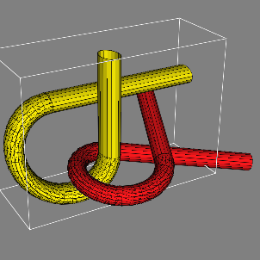
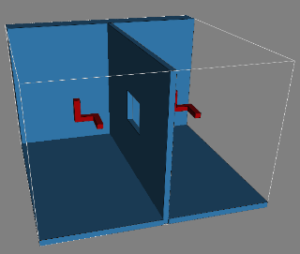
Results

Slide 12
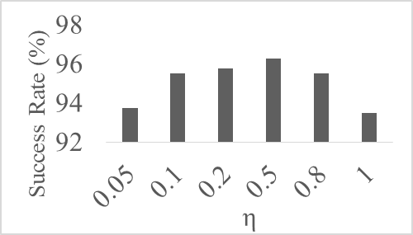
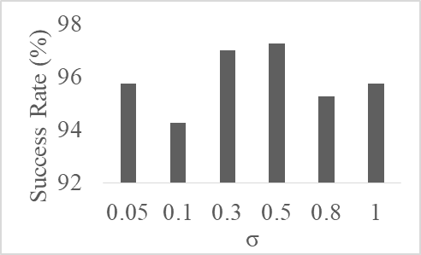
Parameter Assessment

Slide 13
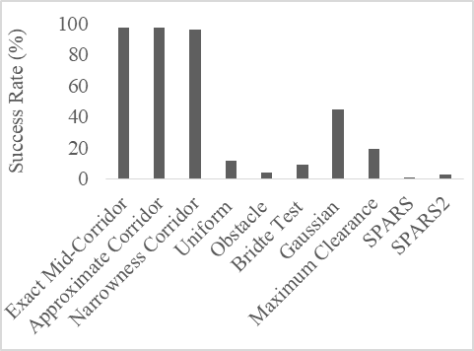
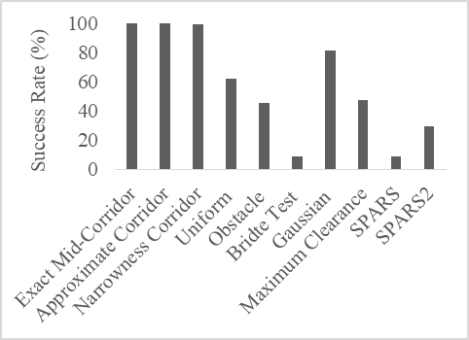
Results for 20 secs

Slide 14
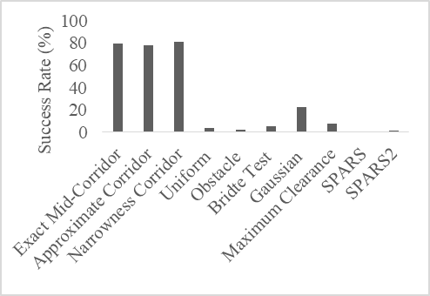
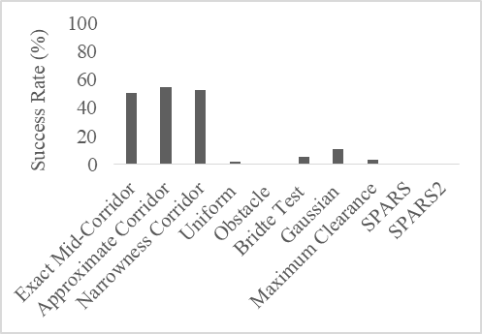
Results for 10 secs

Slide 15
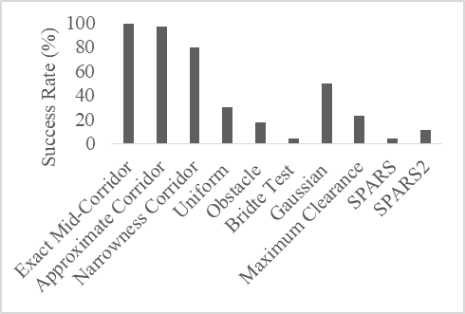
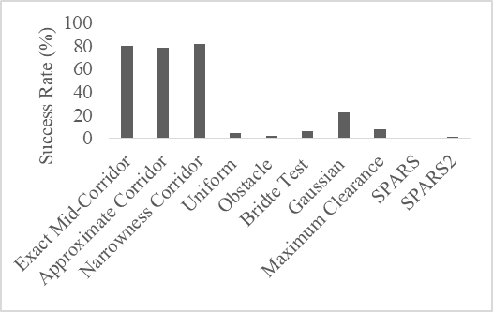
Results for 10 secs

Slide 16
Thank You

