Slide 1
Self-Driving Cars
Towards Apocalypse of Human Driving and Re-Shaping Futuristic Transportation Systems

Slide 2
The Rise of Technology

Slide 3
The Birth
Episode - I

Slide 4
What the hell is happening around?

Slide 5
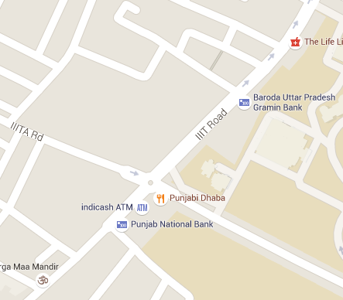
Where the hell am I?

Slide 6
How do I move ahead?

Slide 7
Control??!!!

Slide 8
Dad School of Motor Driving

Slide 9
Lad School of Motor Driving
I Won ☺

Slide 10
Rise of the Machines
Episode - II

Slide 11
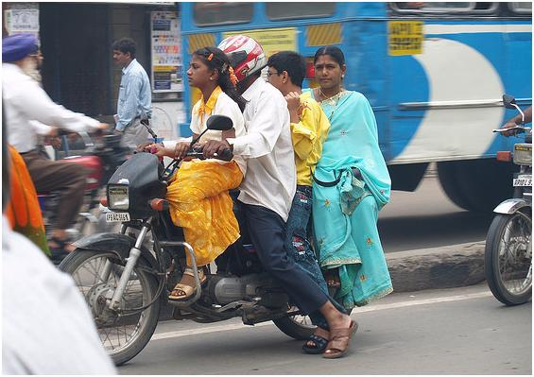
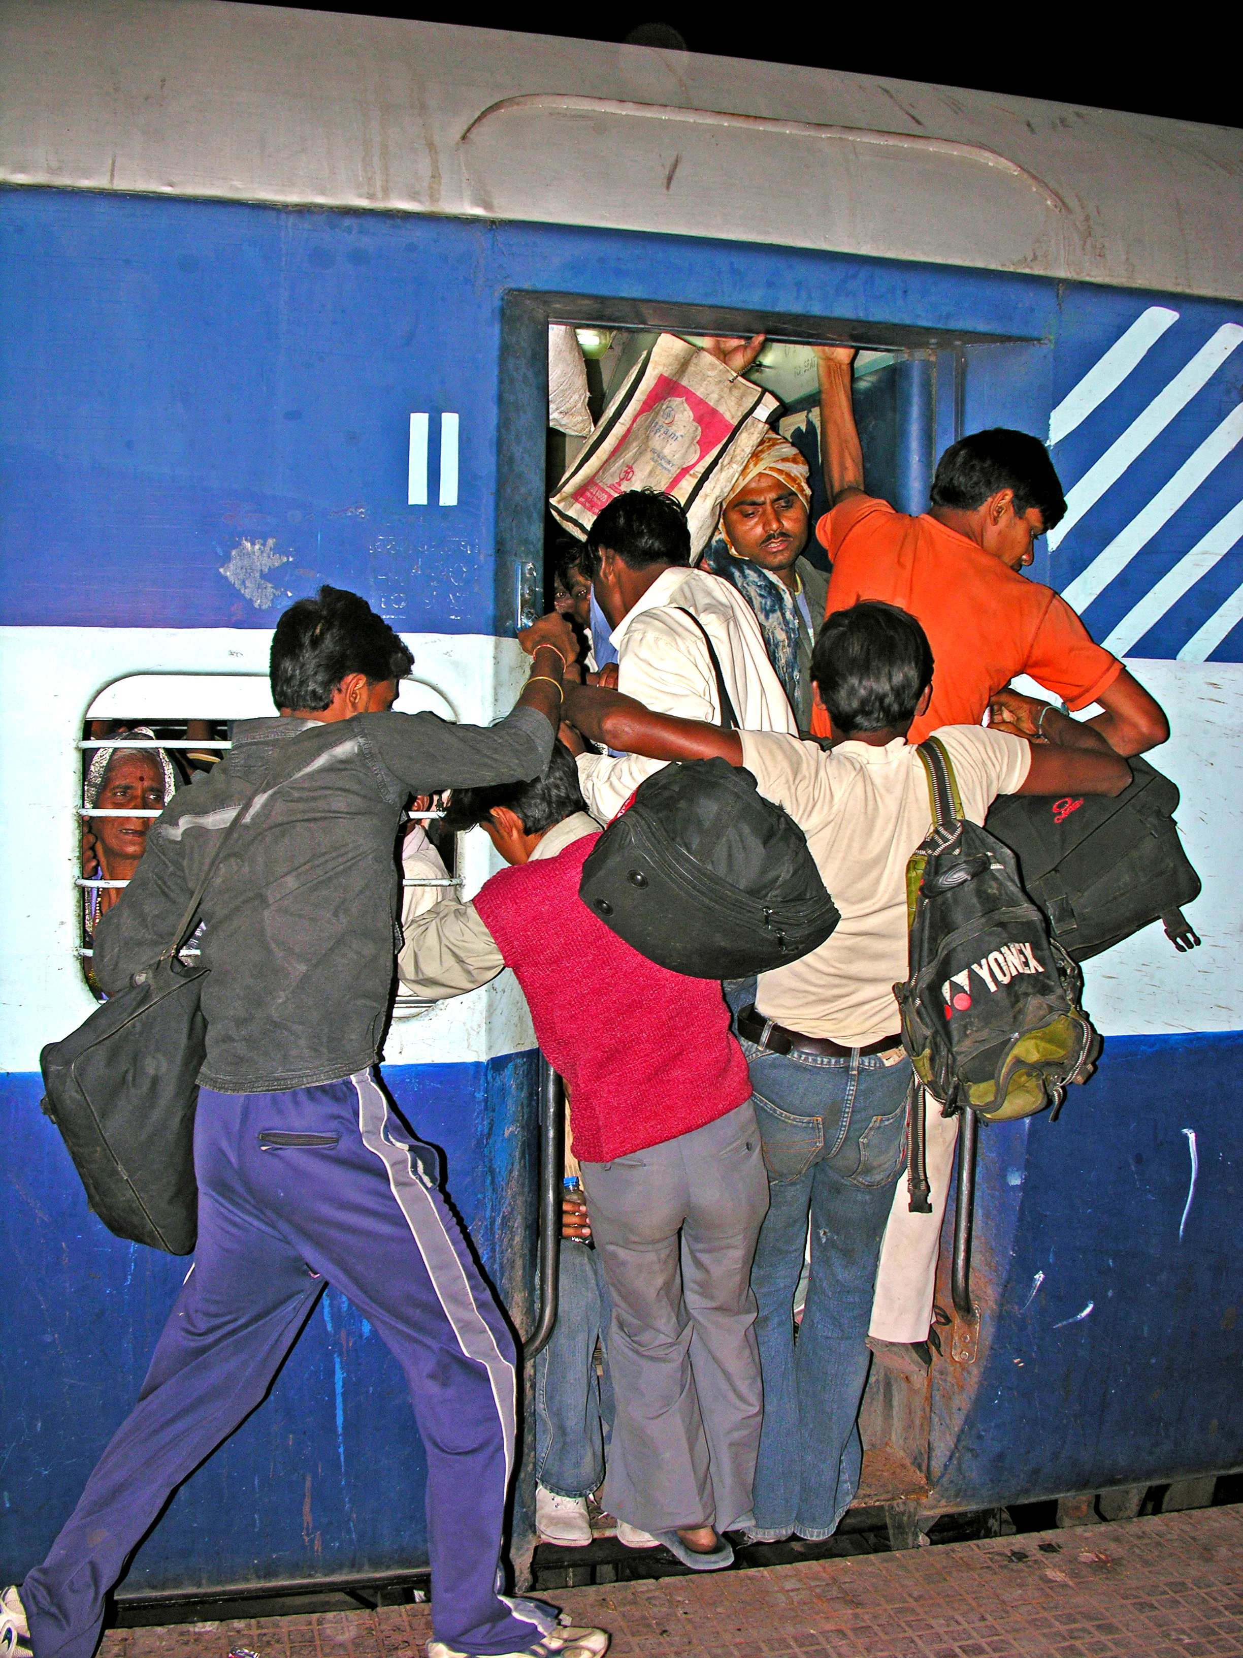
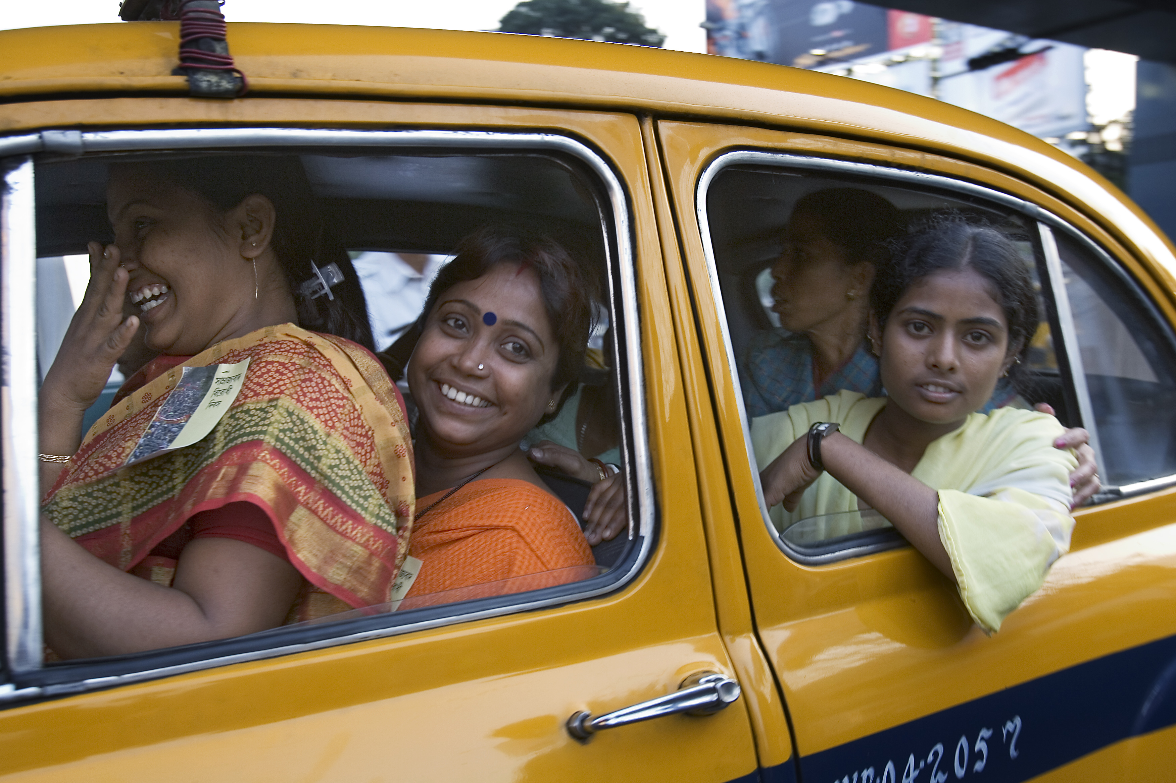

Slide 12
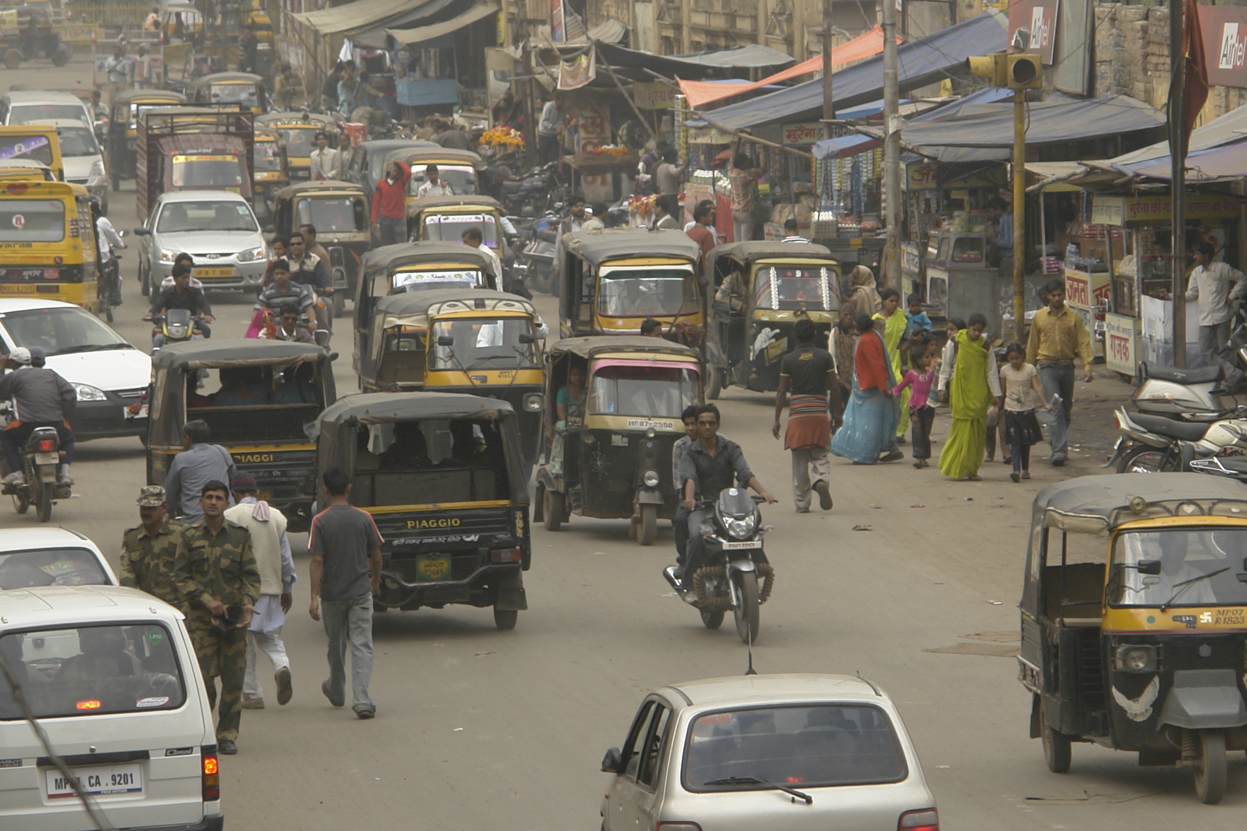

Slide 13
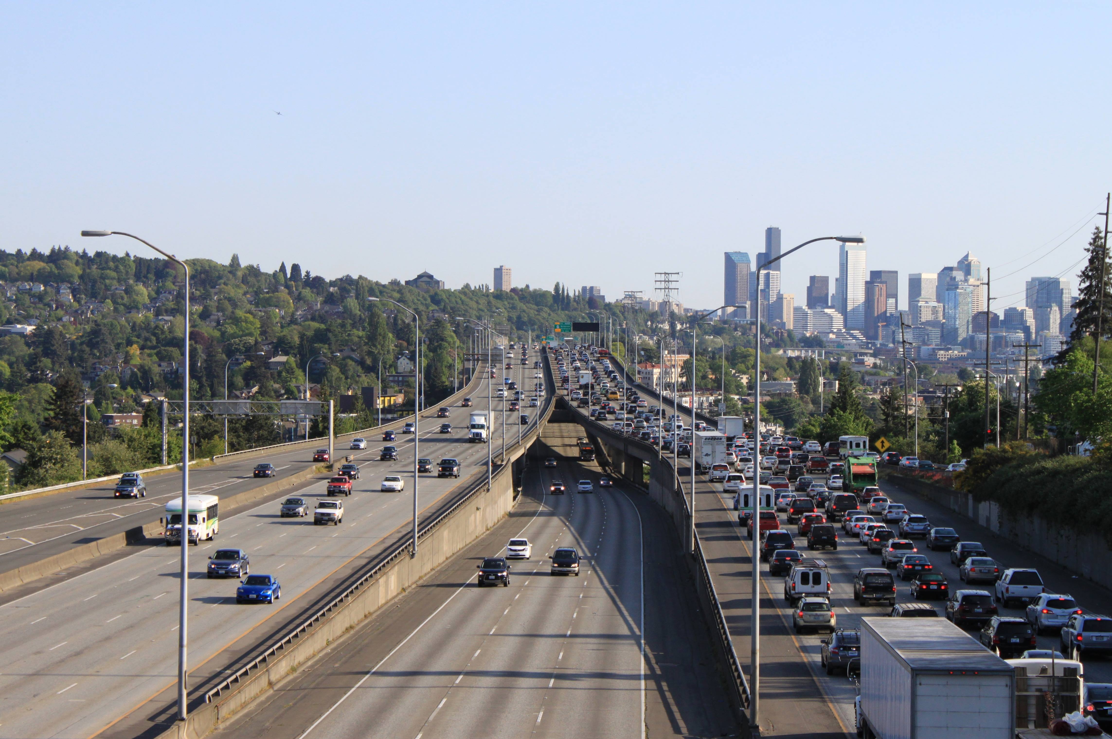

Slide 14
Change the Traffic Rules?

Slide 15
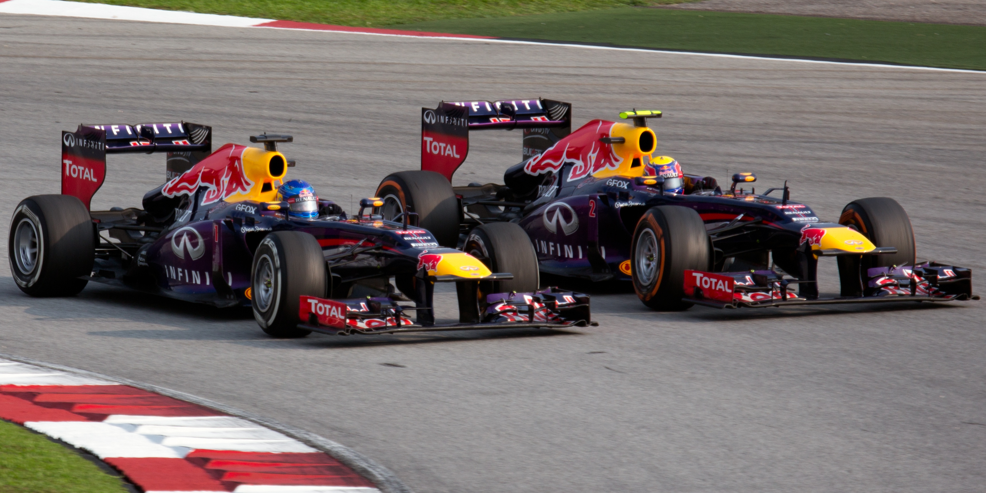
Aggression

Slide 17
The Judgment Day
Episode - III

Slide 19
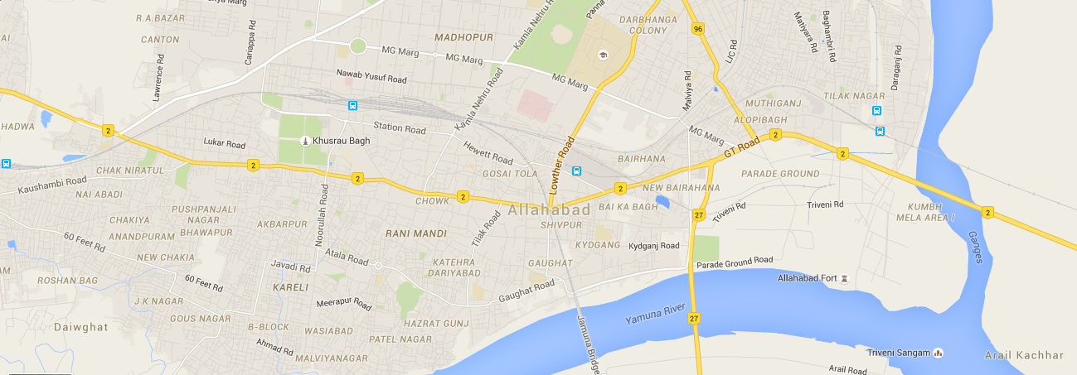

Slide 20
Far in the Future
Episode - IV

Slide 21
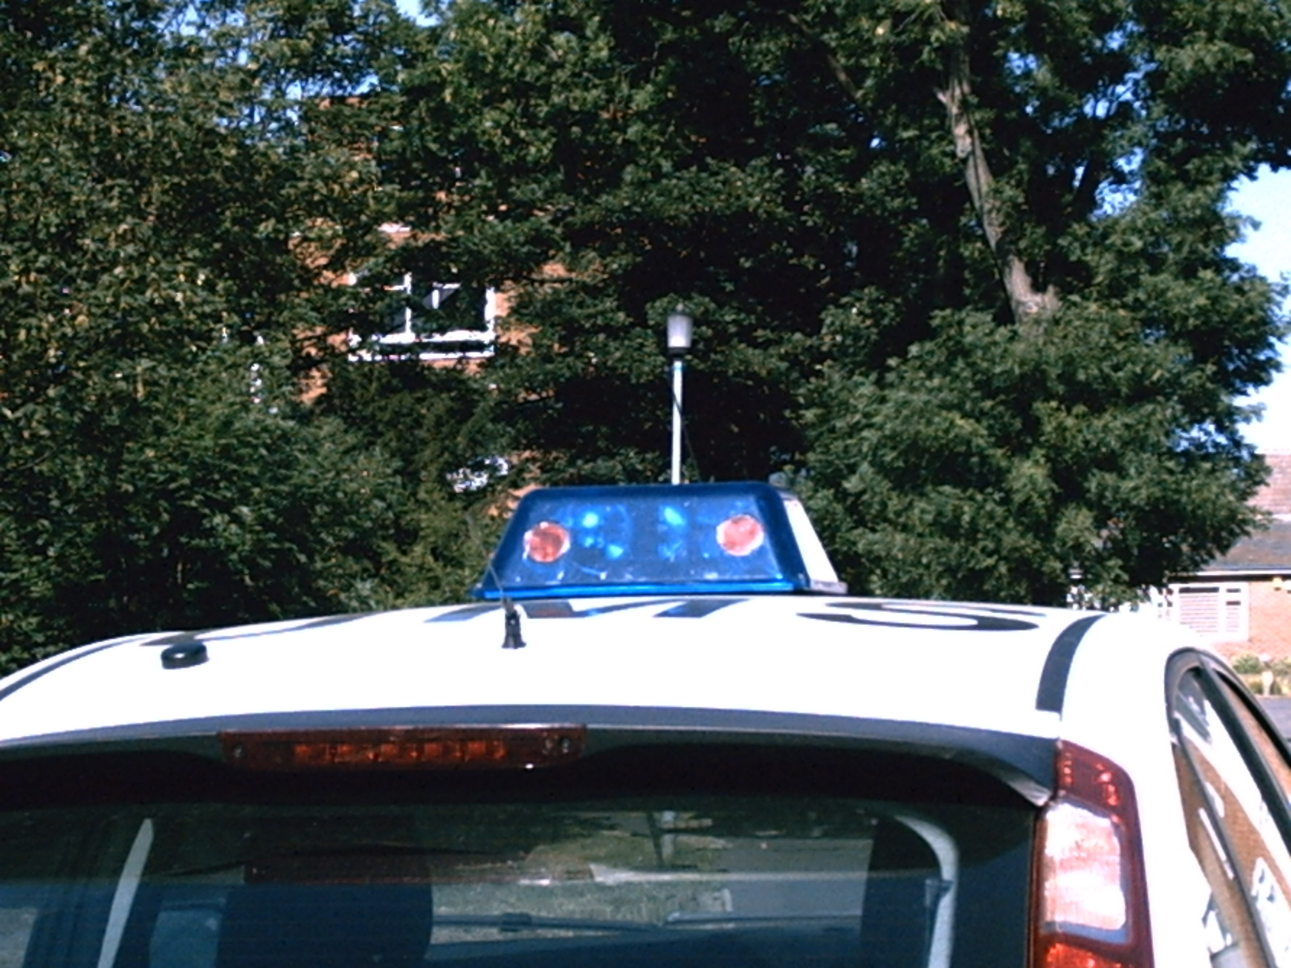
Priorities

Slide 22
The Future

Slide 23
Images Courtesy
https://commons.wikimedia.org/wiki/File:Family_transport_on_bike,_Hyderabad_India.JPG (CC-BY-2.0)
https://commons.wikimedia.org/wiki/File:India_crowded_train.jpg (CC-BY-SA-2.0)
https://commons.wikimedia.org/wiki/File:India_-_Kolkata_girls_-_2996.jpg (CC-BY-SA-3.0)
https://commons.wikimedia.org/wiki/File:Road_traffic_in_Gwalior.jpg (CC-BY-SA-4.0)
https://commons.wikimedia.org/wiki/File:I-5_southbound_traffic_from_NE_45th_Street_in_Seattle.jpg (CC-BY-SA-2.0)
https://commons.wikimedia.org/wiki/File:Sebastian_Vettel_overtaking_Mark_Webber_2013_Malaysia_1.jpg (CC-BY-SA-3.0)
R. Kala, K. Warwick (2013) Planning Autonomous Vehicles in the Absence of Speed Lanes using an Elastic Strip. IEEE Transactions on Intelligent Transportation Systems, 14(4): 1743-1752.
R. Kala, K. Warwick (2014) Dynamic Distributed Lanes: Motion Planning for Multiple Autonomous Vehicles. Applied Intelligence, 41(1): 260-281.

