Slide 1
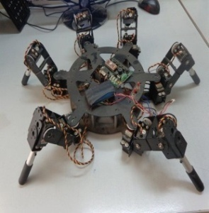
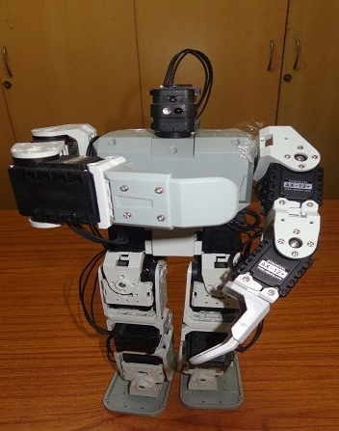
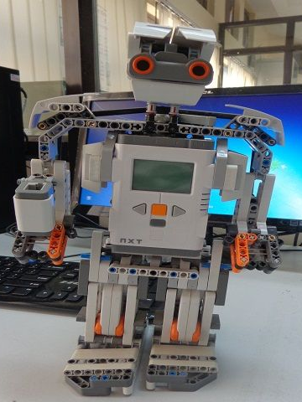
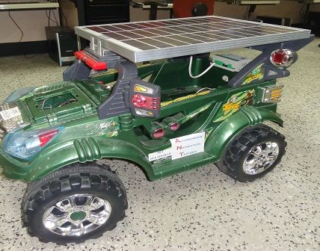
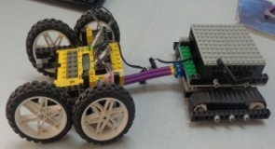
Robot Motion Planning: Approaches and Research Issues
Robotics and Artificial Intelligence Laboratory
Indian Institute of Information Technology, Allahabad
Rahul Kala

Slide 2
Problem Solving in Mobile Robotics
Environment
Data Collection
Environment Understanding
Localization
Map building
Sensor Fusion
Planning
Control
Manipulation
R. Tiwari, A. Shukla, R. Kala (2013) Intelligent Planning for Mobile Robotics:Algorithmic Approaches, IGI Global Publishers,Hershey, PA.

Slide 3
Planning
Strategic Planning
Milestone Planning
Path Planning
Obstacle Avoidance
Control
Abstration
R. Tiwari, A. Shukla, R. Kala (2013) Intelligent Planning for Mobile Robotics:Algorithmic Approaches, IGI Global Publishers,Hershey, PA.

Slide 4
Problem Definition
Goal
Start

Slide 5
Objective
Travel Time
Travel Speed
Travel Distance
Fuel Economy
Passenger Comfort
Clearance
Smoothness

Slide 6
Research Issues
Large offline/online computation
Unstructured environment
Sensing/control errors
Single/limited obstacle/robot environments
Holonomicity
Human Assistance
Narrow Corridors
Dynamic Environment
Wide maps
Congested environments
A priori known environment
Trap-prone environments

Slide 7
Base Algorithms
Algorithms
Deliberative
Graph Search Based
Sampling Based
Fuzzy Logic
Artificial Potential Fields
Optimization Based
PRM
RRT
Genetic Algorithm
A*
Reactive

Slide 8
Pros and Cons: Graph search based
Pros
Resolution Optimal
Resolution Complete
Cons
Time Complexity
Discrete states
Discrete action sets
Holonomicity*
Research
Dynamic A* (D*)
Any theta A*
ε optimal A*
* Can be controlled with a different modeling. Not implemented in the codes given

Slide 9
Pros and Cons: PRM
Pros
Probabilistically Optimal
Probabilistically Complete
Cons
Narrow corridor problem
Roadmap generation not for dynamic environments
Reasonable Computation time
Holonomicity
^{Research}
Lazy PRM
Vision based PRM
K-connectivity PRM
PRM without cycles
Obstacle based sampling
Suited to non-holonomicity

Slide 10
Pros and Cons: RRT
Pros
Probabilistically Complete
Cons
Narrow corridor problem
Near real time performance
Not optimal
Voronoi bias
Practically not complete
Research
Graph based
Local trees
RRT-Connect
Obstacle based sampling
Exploration in partially known environments

Slide 11
Pros and Cons: Genetic Algorithm
Pros
Probabilistically Complete
Cons
Narrow corridor problem
Research
Computationally Expensive
Shorten Operator
Variable Length Chromosome
Multi-objective optimization
Memetic Computation
Practically not complete
Probabilistically Optimal
Lazy collision checker

Slide 12
Pros and Cons: Reactive Methods
Pros
Real time
Cons
Not optimal
Research
Can accommodate uncertainties
Not complete
Trap prone
Training methods
Input modeling
Heuristic decision making

Slide 13
And some ‘hybrids’

Slide 14
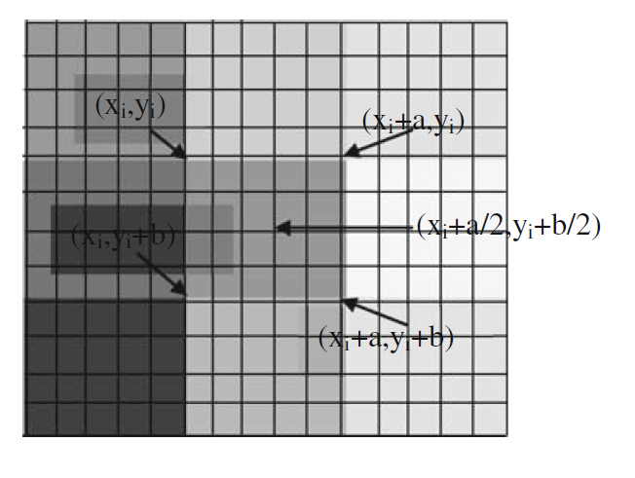
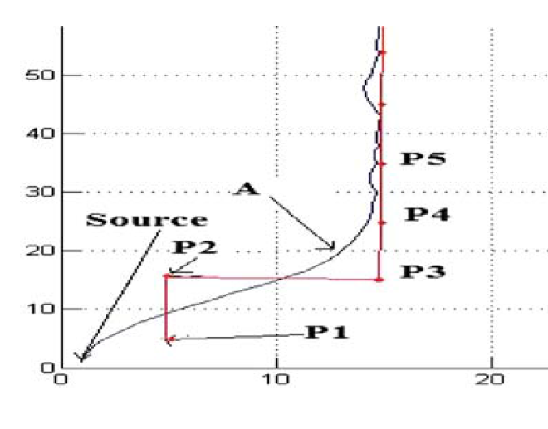
A* and Fuzzy
R. Kala, A. Shukla, R. Tiwari (2010) Fusion of probabilistic A* algorithm and fuzzy inference system for robotic path planning. Artificial Intelligence Review, 33(4): 275-306.

Slide 15
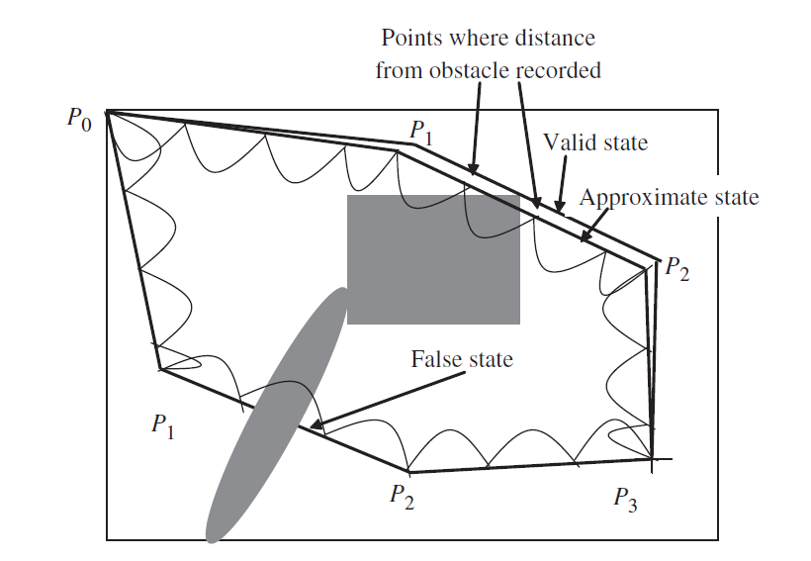
A ‘better’ Genetic Algorithm
Soft Mutation
Insert
Repair
Variable Length Individual
Hard Mutation
Elite
Shorten
R. Kala, A. Shukla, R. Tiwari (2011) Robotic Path Planning using Evolutionary Momentum based Exploration. Journal of Experimental and Theoretical Artificial Intelligence, 23(4): 469-495.

Slide 16
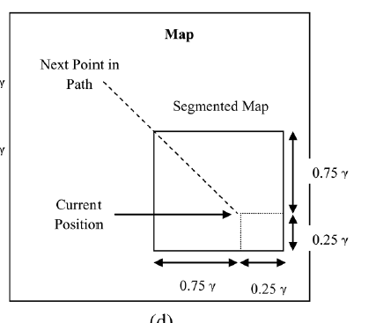
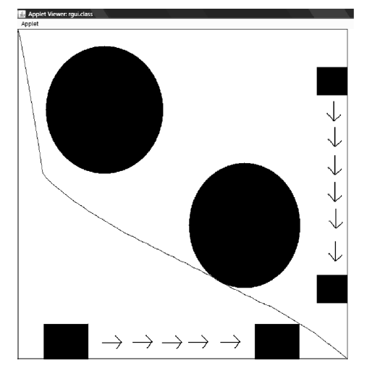
Genetic Algorithm + Genetic Algorithm
R. Kala, A. Shukla, R. Tiwari (2010) Dynamic Environment Robot Path Planning using Hierarchical Evolutionary Algorithms. Cybernetics and Systems, 41(6): 435-454.

Slide 17
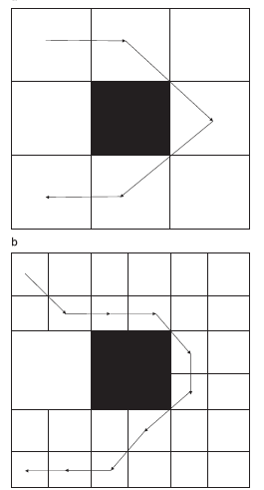
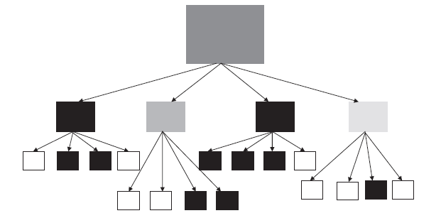
Hierarchical A*
Multi Resolution Graph Representation
R. Kala, A. Shukla, R. Tiwari (2011) Robotic path planning in static environment using hierarchical multi-neuron heuristic search and probability based fitness. Neurocomputing, 74(14-15): 2314-2335.

Slide 18
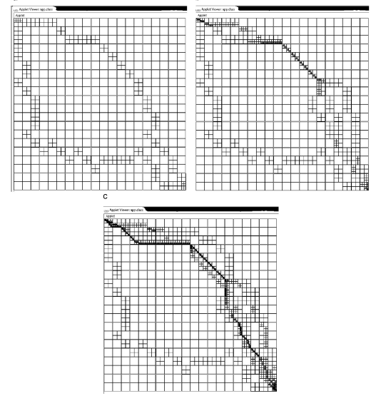
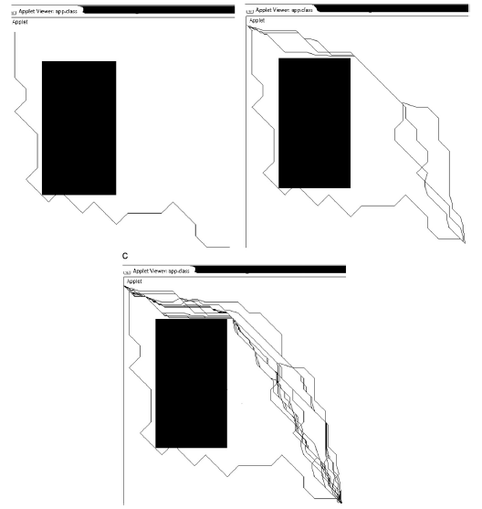
Hierarchical A*
R. Kala, A. Shukla, R. Tiwari (2011) Robotic path planning in static environment using hierarchical multi-neuron heuristic search and probability based fitness. Neurocomputing, 74(14-15): 2314-2335.

Slide 19
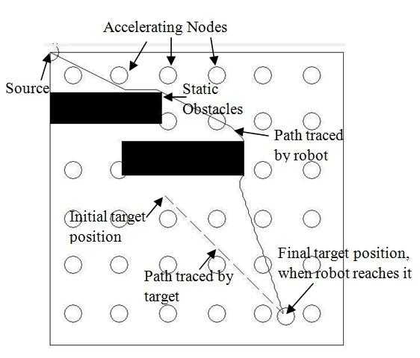
2-layered Dynamic Programming
R. Kala, A. Shukla, R. Tiwari (2012) Robot Path Planning using Dynamic Programming with Accelerating Nodes. Paladyn Journal of Behavioural Robotics, 3(1): 23-34.

Slide 20
And all this extended to Multi-Robotics

Slide 21
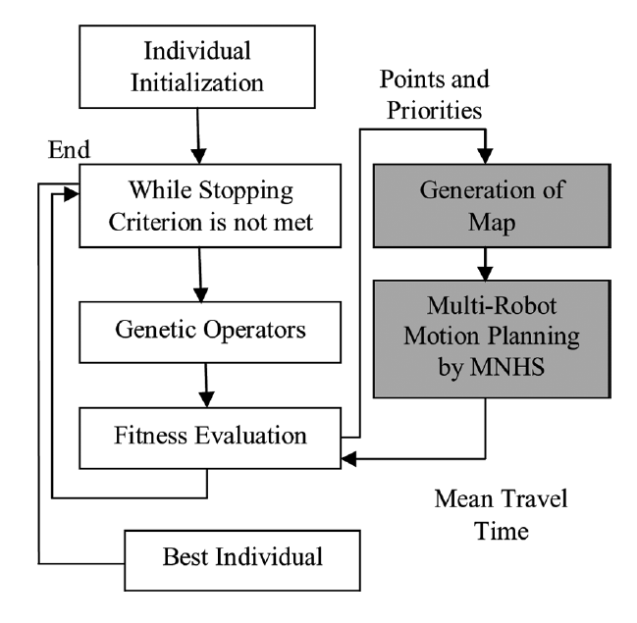
A* + GA
R. Kala (2013) Multi-Robot Motion Planning using Hybrid MNHS and Genetic Algorithms. Applied Artificial Intelligence, 27(3): 170-198.

Slide 22
Rapidly-exploring Random Graphs
R. Kala (2013) Rapidly-exploring Random Graphs: Motion Planning of Multiple Mobile Robots. Advanced Robotics, 27(14): 1113-1122.

Slide 23
Coordination using Local Optimization
R. Kala (2014) Coordination in Navigation of Multiple Mobile Robots. Cybernetics and Systems, 45(1): 1-24.

Slide 24
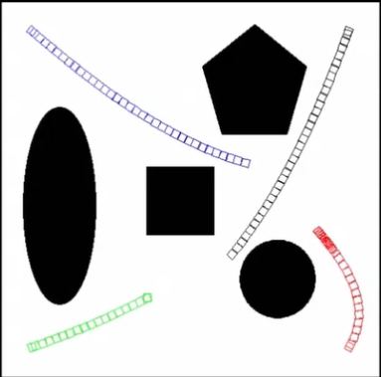
Coordination using Local Optimization
R. Kala (2014) Coordination in Navigation of Multiple Mobile Robots. Cybernetics and Systems, 45(1): 1-24.

Slide 25
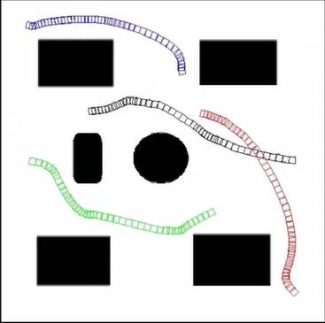
Coordination using A* + Fuzzy
R. Kala (2014) Navigating Multiple Mobile Robots without Direct Communication. International Journal of Intelligent Systems, DOI: 10.1002/int.21662 [Accepted, In Press].

Slide 26
Thank You

