Slide 1
Into an automated, cooperative, diverse and integrated futuristic transportation system
Motion Planning for Multiple Autonomous Vehicles
Rahul Kala

Slide 2
Organized and Unorganized Traffic
A distant future where all vehicles would autonomously be driven would be preceded by a transient period where automated and nonautomated vehicles coexist.
Vanholme, B.; et al. "Highly Automated Driving on Highways Based on Legal Safety," IEEE Transactions on Intelligent Transportation Systems, vol.14, no.1, pp.333-347, March 2013

Slide 3
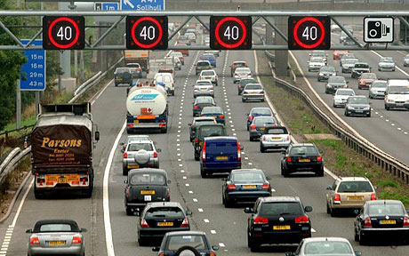
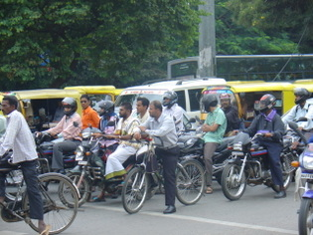
Organized and Unorganized Traffic
Unorganized
Organized
Image Courtesy: railway-technical.com, blogs.abc.net.au

Slide 4
Thesis
Thesis
Trajectory Generation
Intelligent Management of the Transportation System

Slide 5
Trajectory Generation
Static Obstacles
A
B
C
a
Select the best plan:
(a) A overtakes B from right, B drifts left, A crosses the obstacles, C waits, (b) A follows B and both cross the obstacles while C waits,
(c) B crosses the obstacles followed by C and A,
(d) C crosses the obstacle a from its left, while A follows B to cross the others

Slide 6
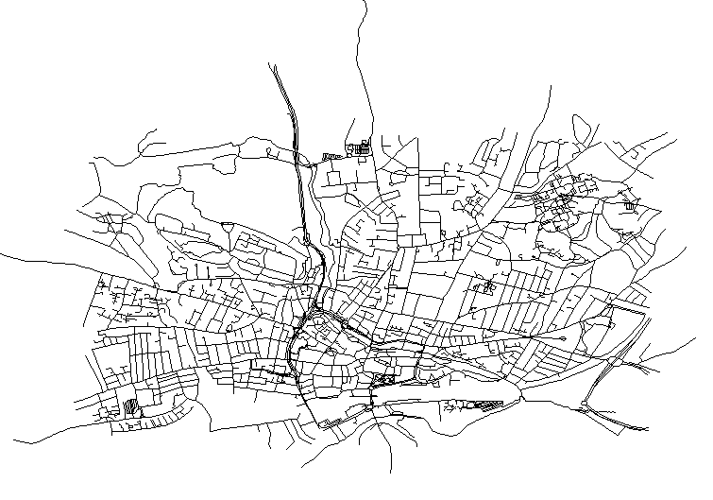
Intelligent Management of the Transportation System
Routing objective/ considerations
Routing frequency
Recurrent or non-recurrent
Traffic Lights
Lane change
Entirely semi-autonomous, mixed, manual
Bookings

Slide 7
Genetic Algorithm
Overtake seems to be too close, ask R₂ to slow
Coordination using traffic heuristics
R₂
R₁
R₃
GA optimized trajectories
R₃ lies directly ahead, ask R₃ to drift to its left
Under revision: Applied Soft Computing, IF: 2.140

Slide 8
RRT
More exploration at the central areas
Less exploration at the extremes
In Proc. IEEE Cybernetic Intelligent Systems, Docklands, London, pp. 20-25

Slide 9
RRT Connect
If prospective collision with a vehicle in the same direction If you cannot overtake, follow – Speed equal to the heading vehicle and re-plan
If going straight ahead possible, go
Tree expansions
If prospective collision with a vehicle in the opposite direction: Decrease speed iteratively and re-plan till a feasible plan is reached
Paladyn Journal of Behavioural Robotics, 2(3): 134-144.

Slide 10
Multi-Level Planning
Layer 1: Road Selection. Blue=selected road. Red= Road graph
Layer 2: Pathway Selection. Collaboratively decide whether each vehicle goes through left or right of an obstacle. Blue=selected pathway. Red=Entire Pathway Graph
Equal distribution of pathway
Layer 3:Pathway Distribution. At each slice (pathway segment) the expected vehicles at the same time are placed. Red=computed points for the vehicle, Blue=Rough trajectory joining the placement points, Green=Other expected vehicle
Layer 4: Trajectory Generation. Smoothing, collision checking, local optimization
J. Intell. Rob. Syst, DOI:10.1007/s10846-013-9817-7, IF: 0.827

Slide 11
Dynamic Distributed Lanes
Check for all strategies in parallel
Use strategy selection heuristics to prune expansion
Use separation maximization heuristic to place all vehicles in the next state
Modify lanes and trajectories of all vehicles
Any general state in graph search
Known trajectory for the state for the higher priority vehicles
Overtake Red?, or Follow Red?, or Wait for green to cross obstacle? – try all 3 possibilities

Slide 12
Fuzzy Logic
Rules
Prototype human designed
Later optimized by Genetic Algorithm
Distance from left, right and front boundary/ obstacle
Side: distance of vehicle in wrong side
Angle deviation from road
Turn to avoid obstacle/ overtake vehicle in front
Requested turn: turn to enable another vehicle to overtake
Fuzzy Inference System
Inputs
Outputs
Steering
Speed
Overtake feasibility assessment
Choose between overtaking and vehicle following
Frame inputs accordingly

Slide 13
Lateral Potentials
Add potential from all sources, each source indicates whether to steer left or right, and by what magnitude
Side Potential: turn right, inversely proportional to distance
Diagonal Potential: turn right, inversely proportional to distance
Back Potential: right/left decided by heuristics/ strategy parameter, time to collision
Forward Potential: right/left decided by heuristics/ strategy parameter, time to collision
Side Potential: turn left, inversely proportional to distance
Diagonal Potential: turn left, inversely proportional to distance
In Proc. IEEE Intelligent Vehicles Symposium, Alcalá de Henares, Spain, pp. 597-602.

Slide 14
Elastic Strip
Repulsive potentials on strip from vehicles, obstacles, road boundaries
Elastic Strip representing trajectory
Assign highest safe speed as per current position, trim plan such that it is feasible
Projected position at the time of arrival
On seeing any new vehicle/ obstacle, try both overtaking from left and right and pick the better plan
IEEE Trans. on Intell. Transp. Syst., DOI: 10.1109/TITS.2013.2266355, IF: 3.064

Slide 15
Logic Based Planning
Assess Scenario
Find the highest priority applicable behaviour
Navigate as per the selected behaviour
Cater to in behaviour specifications
Behaviours in decreasing order of priority
Obstacle Avoidance
Complete single lane overtake
Centring
Lane Change
Overtake
Single lane overtake
Cancel single lane overtake
Be overtaken
Maintain Separation Steer
Slow Down
Discover Conflicting Interests
Travel Straight
Engineering Applications of Artificial Intelligence, 26(5-6): 1588–1601.

Slide 16
Semi-Autonomous Intelligent Transportation System
Lane Booking
Road Booking
Booking Specifications
Booked?
Booked?
Speed Lane Module
Speed Limit
Vehicle Route Planning
Speed of vehicles at lanes
Lane change, Follow, Stop/Start, Turn
Traffic Info.
Scenario Specification
Central Information System
Vehicle Motion Planning
Vehicle Control
Map/Initial conditions
Traffic at roads
Signal state
Vehicle Monitoring
Traffic Signal Module
Position/ Speed

Slide 17
Congestion Avoidance in City Traffic
(Re-)Plan at every crossing
Make frequent effective short term plans
Hypothesis
Plan for a threshold distance from the source
Assume it is possible to reach the goal from the planned state
Like human drivers always see the current traffic and take the best route towards the goal, assuming no dead ends
Minimize
(i) Expected travel time
(ii) Expected traffic density
(iii) Expected time to wait at crossings

Slide 18
Reaching Destination before Deadline with Intelligent Transportation Systems
More importance of reaching on time = more resistance to risk = earlier start time = high probability of reaching = higher α, and vice versa
High deviation = vehicles in that road vary largely in speed = road is less reliable and should be avoided = larger resistance to risk, and vice versa
Speed assumed for route planning =
Learnt Average Speed - α.Learnt Deviation
Intelligent Agents Placed at every intersection
Monitor all incoming vehicles. Learn
average speed and variation
Road Network Graph
Road

Slide 19
Reaching Destination before Deadline with Cooperative Intelligent Transportation Systems
Vehicle States
Various times at every intersection
Cooperative ITS
Cooperative Traffic Lights
Cooperative Lane Changes
Give Up State
Cancel Time
Very Late State
Late Time
Times in increasing order
Late State
Expected Time
Change lights with a preference to the vehicles running late
Change lane to make way for the vehicle running more late
Comfortable State
Cost of lateness

Slide 20
Results

Slide 21
Conclusions
Situational assessment
Context assessment
Algorithm switching
Studying the problems in local settings, using regional data sets
The future is unknown and diverse!

Slide 22
Thank You
Acknowledgements:
Commonwealth Scholarship Commission in the United Kingdom
British Council

